Slide 1
Office of Student Accounts Jordan Hall, 102 Butler.edu/student-accounts
****************************************************************************************************************************
Email: studentaccounts@butler.edu
Call: 317-940-9353
Check us out:
Facebook.com/ButlerUniversityStudentAccounts
Follow us:
Instagram.com/studentaccounts

Slide 2
Office Hours
Monday, Tuesday, Thursday, Friday
9:00 a.m. – 4:00 p.m.
Wednesday
11:00 – 4:00 p.m.

Slide 3
General Services Provided
Publish an electronic billing statement (E-Bill) the second Wednesday of every month.
Administer the Monthly Payment Plan option.
Process refund checks when classes are in session for students with credit balances.
Provide student account counseling
Post paper check payments including 529 plan payments to individual accounts.
Provide billing invoices to third parties upon request & receipt of authorization.

Slide 4
E-Bill (Electronic Billing)
All billing statements are electronic. E-Bills are published the 2nd Wednesday of every month.
When the E-Bill is published, notifications are sent via email from
billing@butler.edu to students and all Authorized Payers.
The first E-Bill for the fall semester is published in July and due in full in August.
The first E-Bill for the spring semester is published in December and due in full in January.
E-Bill Publish Dates & Due Dates are available on our website.

Slide 5
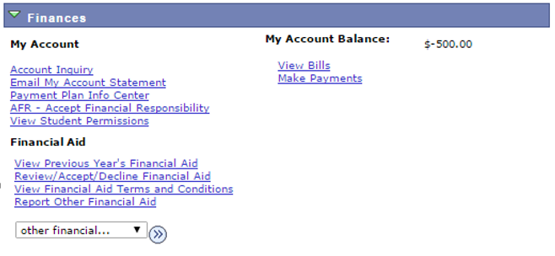
STUDENT ACCESS to E-Bill & E-Pay System
Log into my.butler.edu account
Select Self Service Student Homepage
Navigate to Student Center
Click on View Bills which links to E-Bill & E-Pay System

Slide 6
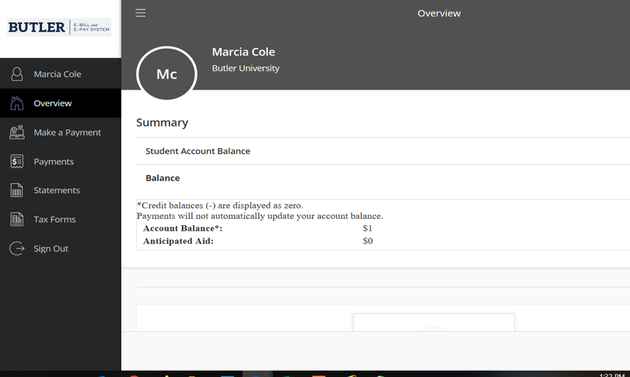
E-Bill & E-Pay System
Click on Statements to view your E-Bill.
Click on Make a Payment to submit electronic payments from a checking or savings account or a credit card payment.
Please keep in mind there’s a non-refundable convenience fee charged for all credit card payments.

Slide 7
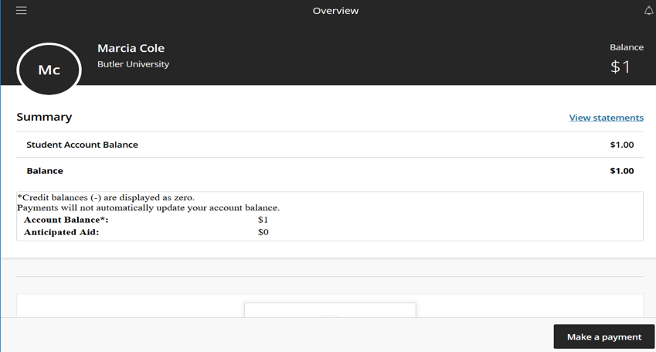
Viewing the E-Bill After clicking on Statements (previous slide), click on View Statements then View (below).

Slide 8
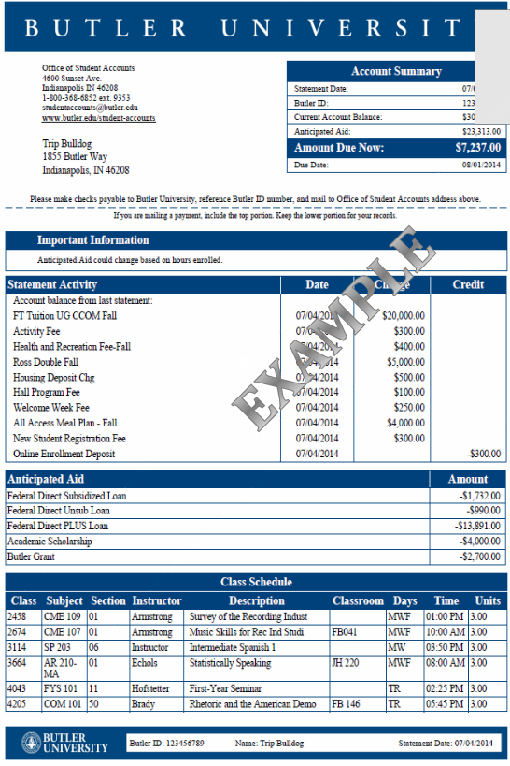
The E-Bill
Includes:
Student’s information and BU ID
Our contact information & mailing address
The Amount Due Now & due date
Statement Activity-an itemized list of charges & credits (e.g. tuition, fees, housing, enrollment deposit)
Itemized list of Anticipated Aid
Class schedule

Slide 9
Anticipated Aid
Financial aid is “anticipated” until the aid posts to the student’s account on the 5th day of class.
Anticipated Aid is included in the calculation for the Amount Due Now.
Any pending financial aid funds (e.g. scholarships from “outside” sources) aren’t included in the Anticipated Aid until the funds have been received & processed by the Office of Financial Aid.
Federal Direct Loan Funds require the student to complete a Master Promissory Note (MPN) & Entrance Counseling (online questionnaire) before the loan funds will post to the student’s account. Questions? Contact Financial Aid at finaid@butler.edu prior to the due date for details.

Slide 10
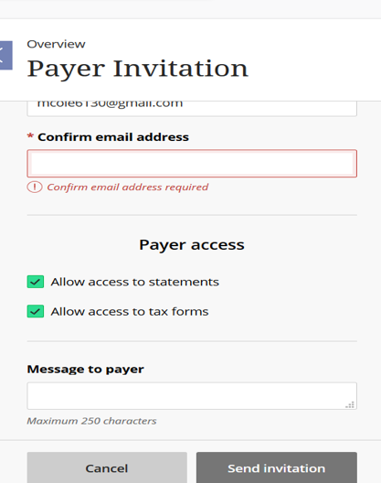
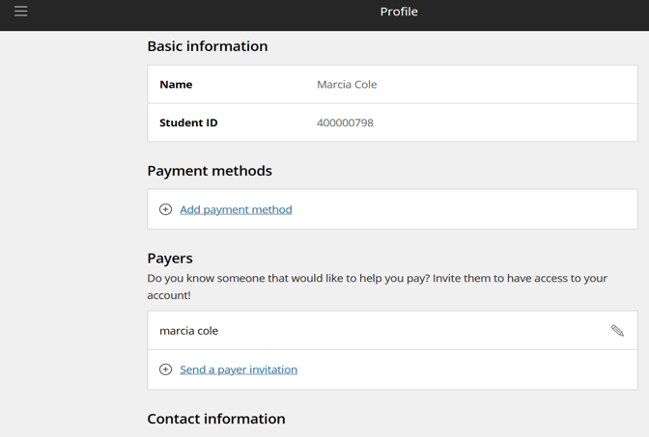
Authorized PAYERS
Anyone assisting student with financial obligation.
To provide Payers access to E-Bill & E-Pay System, students must log into E-Bill & E-Pay and send Payer(s) an invitation after completing all information.
Payer receives an e-mail from e-pay@butler.edu with a temporary password. (Check Junk or Spam if email isn’t received in the email IN box.)
Payer receives an email when the E-Bill has been published & is available to view.
Web address for access for Authorized Payers:
https://commerce.cashnet.com/butler

Slide 11
E-Bill Helpful Notifications Once students or Authorized Payers are logged into the E-Bill & E-Pay System, helpful notifications, including navigation instructions to make a payment and view the account activity pops up immediately.

Slide 12
Account Activity Updates (located in E-Bill & E-Pay System) Students & Authorized Payers can log in to E-Bill & E-Pay to see if payments have been received and posted to the student’s account or to check on any anticipated charges or credits that have posted by clicking on Account Activity below. The Account Activity is updated once each business day and will provide students and Authorized Payers with the latest account information.

Slide 13
Payment Information
Payment Options
Pay the balance in full by the due date.
Enroll in Monthly Payment Plan.
(students must enroll via their my.butler.edu account during
designated enrollment dates.)
Participate in the Prepaid Tuition Program
(program summary available on our website)
Payment Types
Electronic payment via E-Pay
Checking or savings account (no fee)
Credit card (a non-refundable convenience fee applies)
529 plan payments from a list of supported plans.
529 plan paper check payments. Contact plan administrator and
provide student BU ID & due date.
Personal paper checks (include student’s BU ID on ALL checks).
International payments through PayMyTuition.

Slide 14
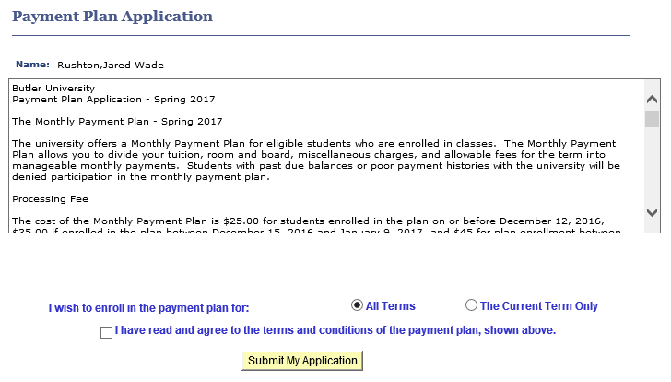
Monthly Payment Plan
Students enroll via my.butler.edu
and must agree to the
Terms & Conditions of the plan before
submitting the application.
Enrollment dates:
Available on our website/
Four payments per fall & spring
terms. A $25 participation fee
applies each semester.
Payment amount equals charges
minus Anticipated Aid divided by
remaining payments in the plan.
Payment amounts may fluctuate
each month. “Pending” funds (e.g
outside scholarships, 529 plan
payments) aren’t considered a
payment or included in the Amount
Due Now on the monthly E-Bill.
After “pending funds are received and processed, the funds are subtracted from the total amount due on the next monthly E-Bill, reducing subsequent payments.

Slide 15
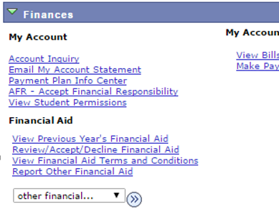
View Student Permissions
Per federal regulations, students must grant permission to allow federal funds such as the Federal Direct Student Loan, PLUS & Pell Grant to pay for miscellaneous costs which include parking decals, bookstore charges, etc.
Students grant permission when logged into their my.butler.edu account.
Granting Permissions is EASY!

Slide 16
Account Inquiry & E-mail My Account Statement
Additional Options under Finances within the Student Center:
Account Inquiry
Provides “real time” charges and credits that have posted to the
account and date posted.
E-Mail My Account Statement
By clicking on this, a pdf. file is sent to student’s BU e-mail address.
The statement provides a recap of all charges and credits that have
posted to the account by term and the date posted.

Slide 17
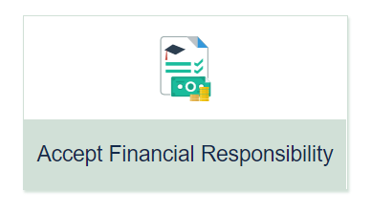
AFR – Accept Financial Responsibility
Butler University policy requires all students to complete the Acceptance of Financial Responsibility (AFR) process each semester prior to enrollment.
Details, including navigation to complete the process, are available on our website.
Note: Students can also access the AFR directly from the my.butler.edu page in the Academic Tools column on the left.

Slide 18
Additional E-Bill Items
Student Health Insurance
Butler University requirement
If student is already covered by a family insurance plan, the charge is waived provided the waiver is completed ONLINE during the designated waiver period.
Waiver must be completed after fall enrollment and prior to August 1st EACH YEAR to avoid the charge for Butler’s Health Insurance. Visit Health Services for details.
Parking Permit
Students must register vehicle with the Butler University Police Department (BUPD) by logging into my.butler.edu.
For details, visit Parking Services website.
Outside Scholarship Checks (RECEIVED)
All outside scholarship information (including checks) are sent directly to the Office of Financial Aid, located in Robertson Hall, lower level for processing.

Slide 19
Tuition Insurance
Butler University has partnered with Allianz Tuition Insurance, provided by GradGuard, a service of Next Generation Insurance Group. Tuition insurance is an optional plan that is available to purchase to meet the needs of our students.
Tuition Insurance can protect your investment (up to the purchased policy limit) for losses incurred if students are forced to withdraw from school due to a medical event such as a covered accident, injury or illness.
GradGuard is a private insurance program that supplements Butler University’s published Institutional Tuition Refund Schedule.
The optional tuition insurance must be purchased prior to the first day of classes for the fall or spring terms.
Additional details, including costs, are available at Gradguard.com/tuition

Slide 20
Tips for Student’s Financial Success
Review the Student Checklist for Financial Success.
Always review your E-Bill when published; note the Amount Due Now, the due date and ensure your payments are submitted by the due date.
Review charges & Anticipated Aid; is everything correct?
If you have any questions at all, please contact us at studentaccounts@butler.edu and we’ll be happy to assist you.
Don’t forget to create your Authorized PAYER accounts and make sure your Authorized Payers receive their temporary password, create a new permanent password and have access to E-Bill & E-Pay.
Check all Butler email messages upon receipt. When action is required, respond quickly!
Best Wishes to you from the Student Accounts Team.
Have a spectacular year!

Slide 21
Office of Student Accounts Jordan Hall, 102 Butler.edu/student-accounts
****************************************************************************************************************************
Email: studentaccounts@butler.edu
Call: 317-940-9353
Check us out:
Facebook.com/ButlerUniversityStudentAccounts
Follow us:
Instagram.com/studentaccounts

